Slide 1
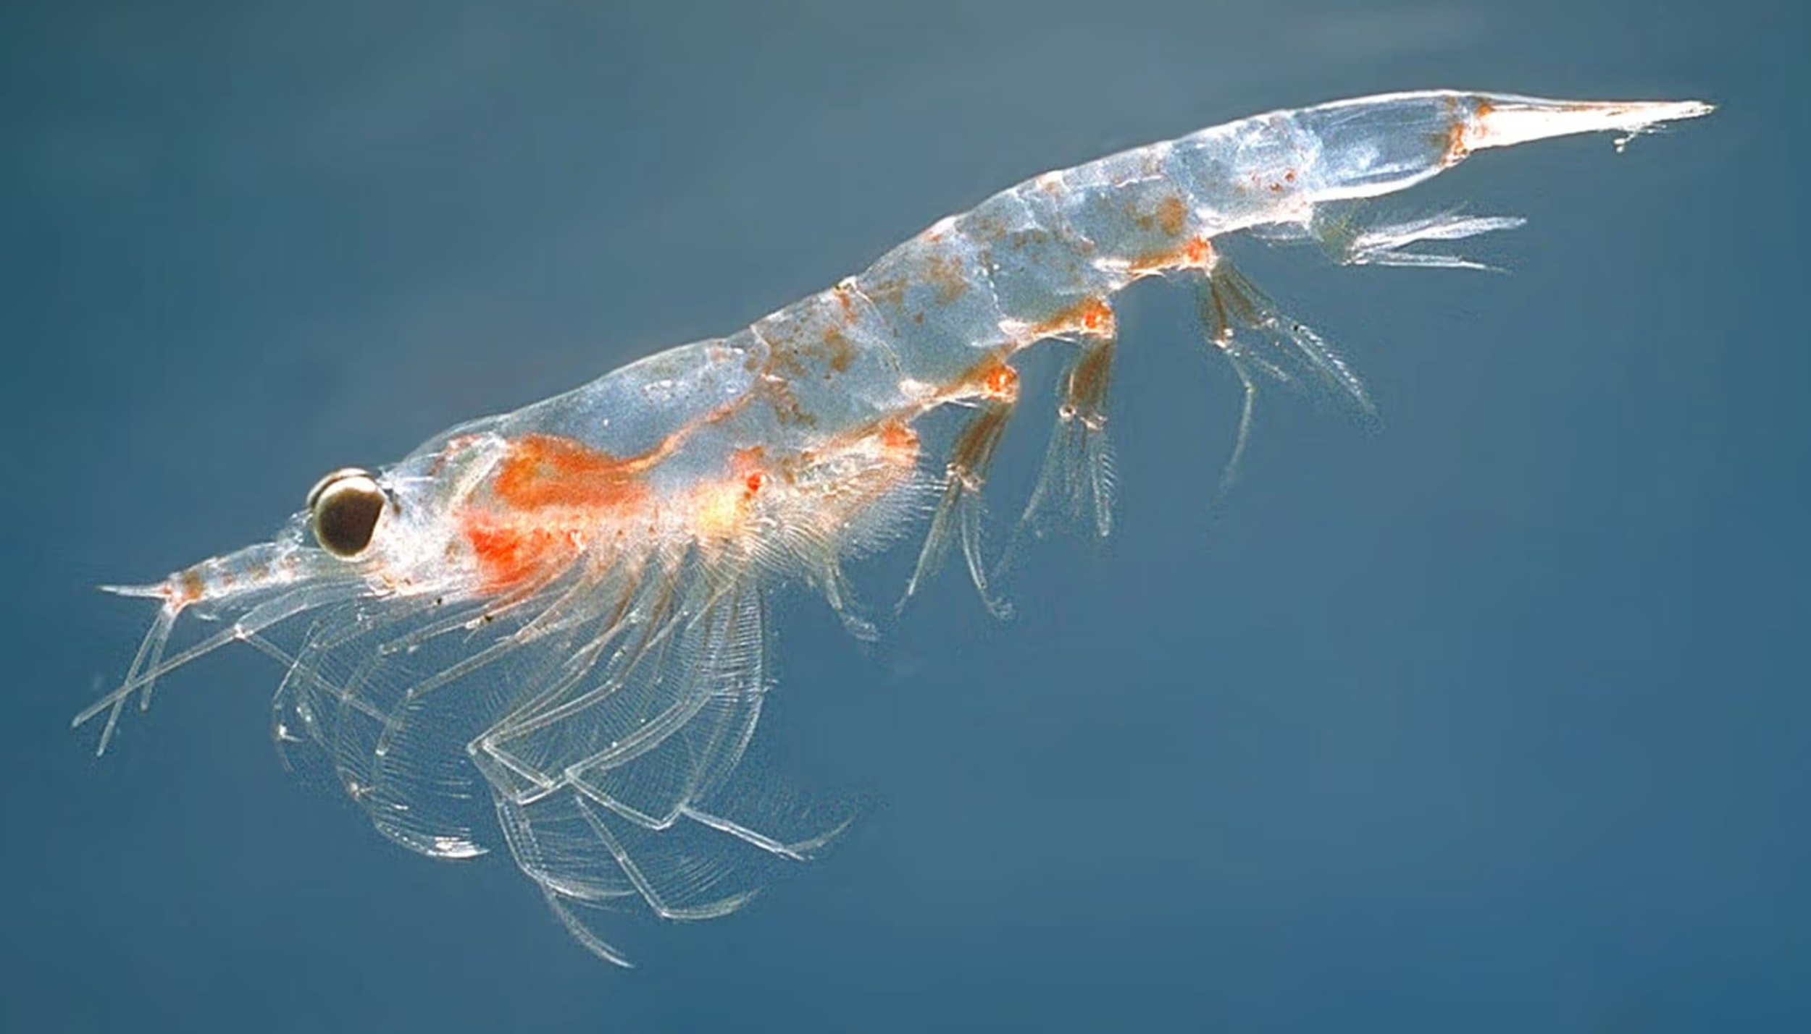
Using Python to View Historical Zooplankton Levels in Madison, WI Area Lakes
Annabelle Majerus

Slide 2

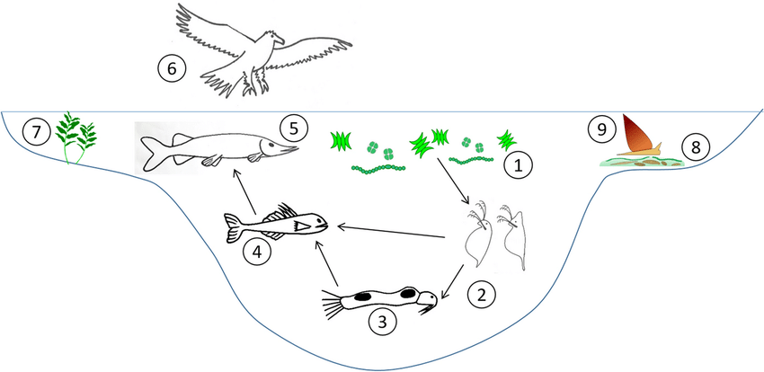

Why Zooplankton?
Role in ecosystem
Characteristics
Indicators of ecosystem health
Aquatic Ecology, June 2022
Notes:
Zooplankton are microorganisms that live in aquatic ecosystems. They serve the roles of primary and secondary consumers, eating phytoplankton and other zooplankton. They are consumed by fish and many other members of aquatic ecosystems, giving them an important intermediary role as nutrients are cycled through the ecosystem. They are highly sensitive to changes in the ecosystem such as nutrient composition, and also have the ability to remain inactive during periods of unfavorable environmental conditions and reinstate their communities when the conditions become favorable again. Due to these characteristics, zooplankton are especially good indicators of the overall health of aquatic ecosystems.
Image Reference:
Aquatic chemical ecology meets ecotoxicology - Scientific Figure on ResearchGate. Available from: https://www.researchgate.net/figure/A-simplified-food-web-typical-for-freshwater-lakes-showing-major-organism-groups-known-to_fig1_357899436 [accessed 6 May, 2024]

Slide 3


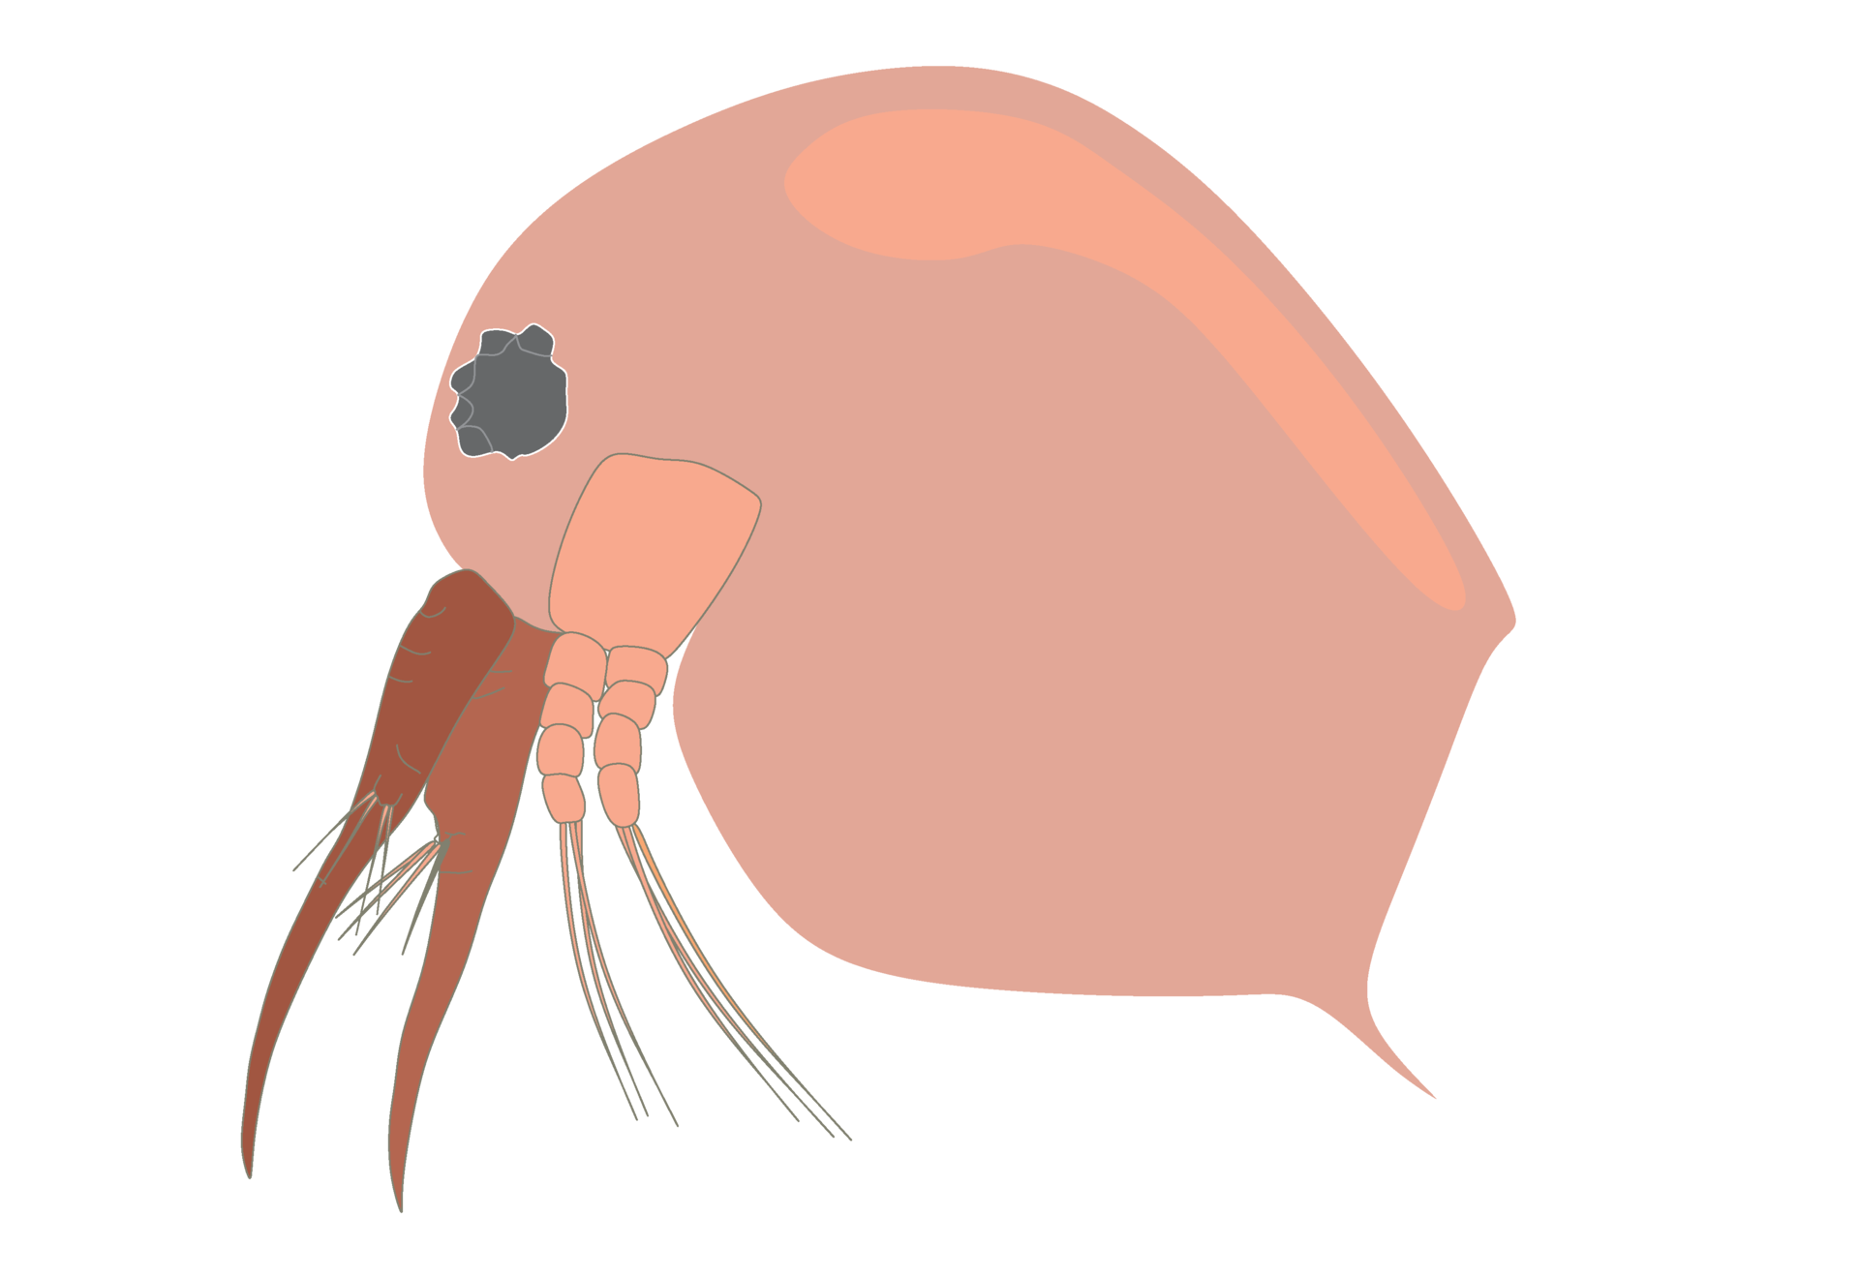
NTL-LTER Datasets
Core Datasets
Madison Area Lakes
Trout Lake Station
Notes:
The North Temperate Lakes Long Term Ecological Research Project is a project by the University of Wisconsin - Madison to provide long-term data on Wisconsin lakes. It operates within the Long Term Ecological Research network that has been funded by the U.S. National Science Foundation since 1981. The project provides publicly-available long-term data covering the five core LTER areas of primary production, population dynamics and trophic structure, organic matter accumulation and use, inputs and movements of nutrients through the ecosystem, and patterns and frequencies of disturbances.
The core datasets for the long-term data cover the Trout Lake Station as well as the Madison Lakes Area. Data on biotic and abiotic is available and can be used for comparison.

Slide 4

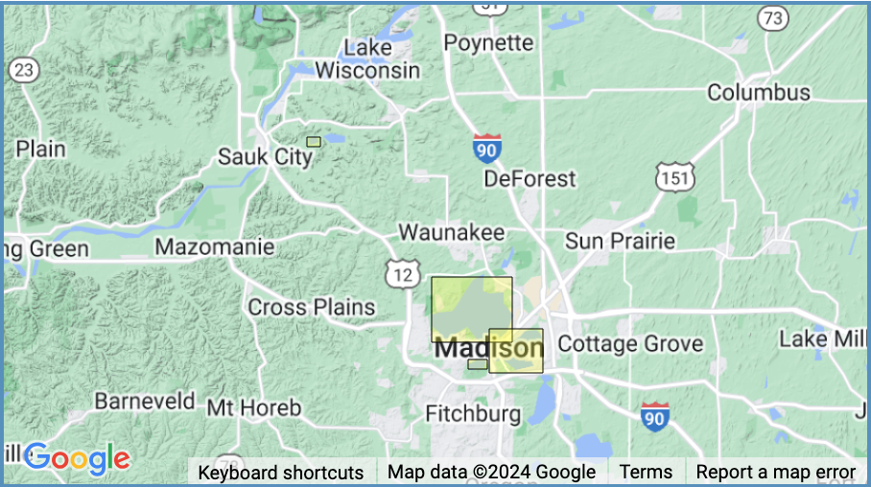

Madison Area Lakes
Mendota, Monona, Wingra, and Fish
Data Preprocessing
Density per m³
Removing missing data
Notes:
I chose to do my visualization and analysis on a dataset that recorded zooplankton densities in the Madison Area Lakes from 1990-2020. The lakes in question were Mendota, Monona, Wingra, and Fish Lakes.
To analyze and visualize my code, I used Python and VisualStudioCode. Data preprocessing included calculating the densities of zooplankton per cubic meter by dividing the density of zooplankton collected and dividing it by the tow depth at which the zooplankton were collected. I removed any missing data, which brought me to 8,994 usable data points to conduct my analysis on.

Slide 5
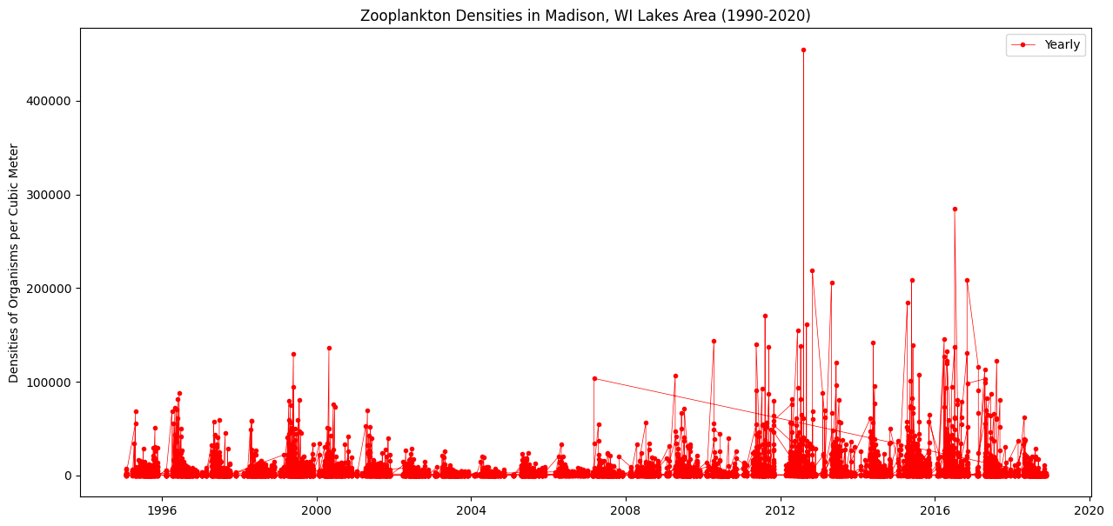
Notes:
I decided that building a time series would be a useful way to visualize the data because of the length of the study that the data was collected from. I started by plotting the densities of zooplankton per cubic meter from 1990-2020. Although there are some pretty significant outlier points, you can see a pretty clear annual cycle with a spike of zooplankton every year in the spring and a decline as the year progresses.
After plotting this, I decided to test the data to see if it was stationary. Because of this seasonal trend I observed visually, I didn’t expect it to be. I ran both an ADF and a KPSS test. My p-value for both tests was less than 0.05, which meant the ADF test found the data to be stationary and the KPSS test found it to be non-stationary. Because of these conflicting results, I decided to difference the data and test again.

Slide 6
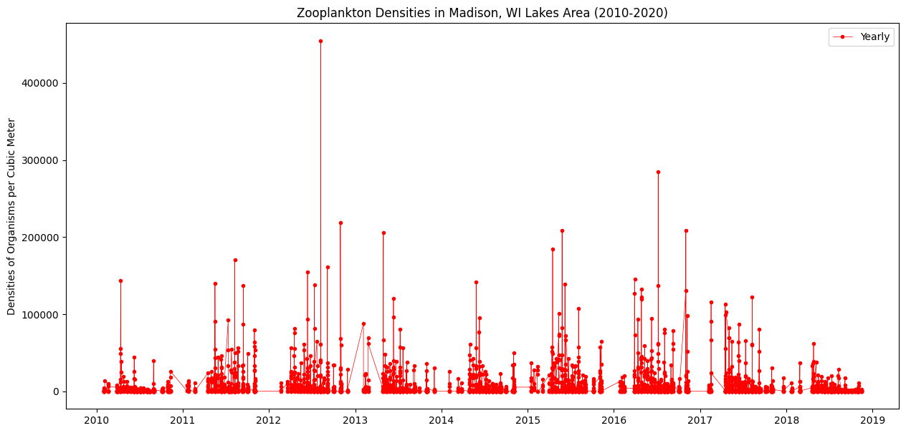
Notes:
Before I performed the tests again, I sliced the data to a smaller time frame of 2010-2020. I also tested the sliced data to see if there was any difference in the test results, but the ADF and KPSS tests still had conflicting results.

Slide 7
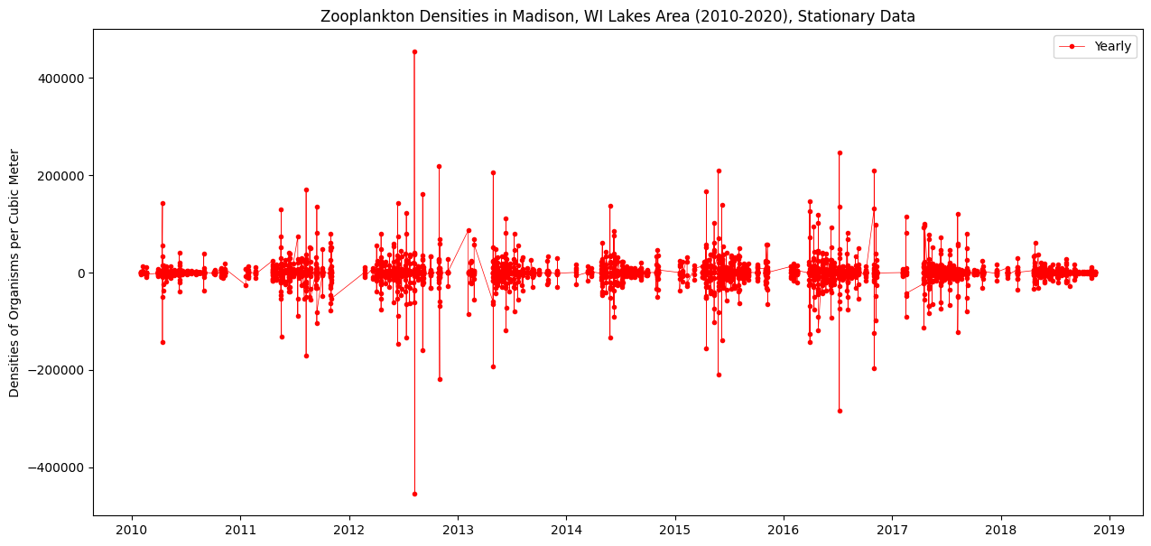
Notes:
Here is the sliced data plotted after the differencing. When I ran my ADF and KPSS tests, they both indicated that the data was stationary.

Slide 8
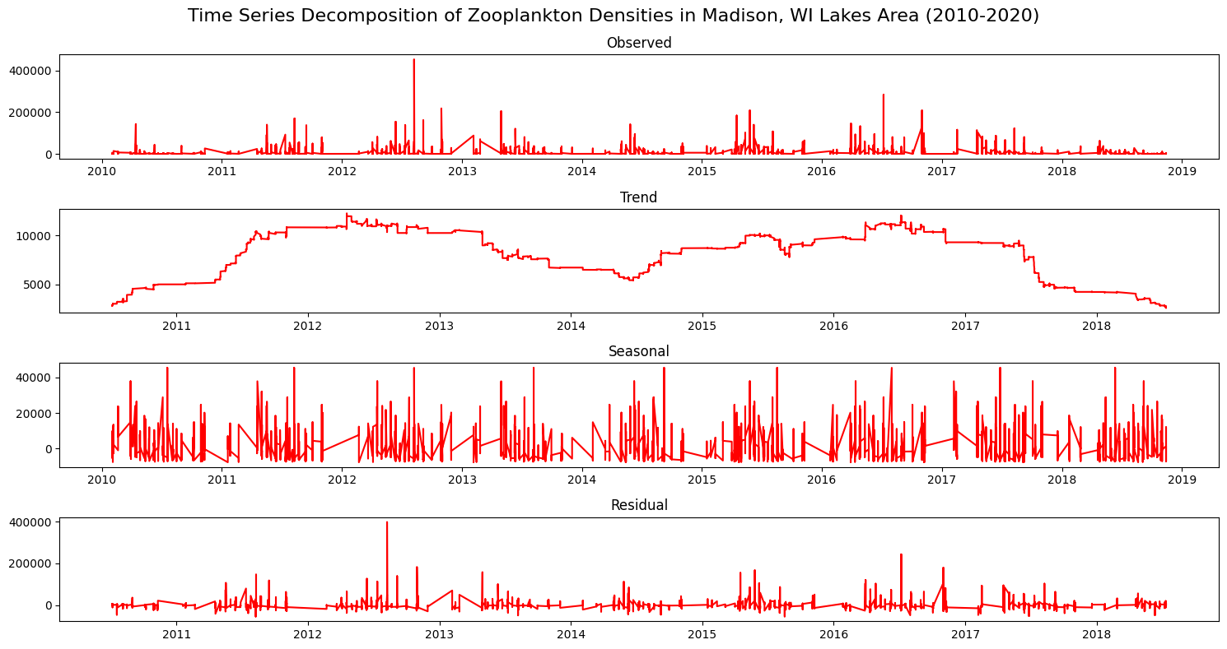
Notes:
The last visualization I created was a time series decomposition of the data from 2010-2020. There wasn’t really a clear story told in this, which made me think about ways that this could be done more effectively. The dataset has a column indicating which species of zooplankton was collected, so It could be useful to create time series based on individual species instead of zooplankton as a whole.

Slide 9


Future Uses
Predicting future levels of Zooplankton based on historical data
Comparing to other datasets
Phytoplankton levels
Time of Ice Melt
Annual Temperature
Lake Phosphorus Levels
Compare to other locations
Trout Lake Datasets
Other limnology studies
Notes:
That brings me into my final thoughts on future uses for this dataset and the NTL-LTER project as a whole. While there is certainly a seasonal component to zooplankton densities, there are many other factors that may have affected population sizes from year-to-year and there are many available datasets that could be used to test for this.
Because zooplankton consume phytoplankton, the data for both types could be compared to look for correlations between rising zooplankton populations and declining phytoplankton populations or vice versa.
As stated earlier, zooplankton are very sensitive to changes in the nutrient composition of their environments. The levels of phosphorus or other nutrients in the lakes throughout the year could be compared to zooplankton population size to check for correlations.
My visualizations were only based on the Madison Area Lakes, but the NTL-LTER project also does the same sampling at the Trout Lake Station in Boulder Junction, Wisconsin. Comparisons could be made between these lakes, which would be especially interesting to see due to the history of pollution in the Madison Area Lakes.
Overall this data has many uses and possibilities of what can be learned from it. Understanding and evaluating it can help with future lake management practices.

Slide 10
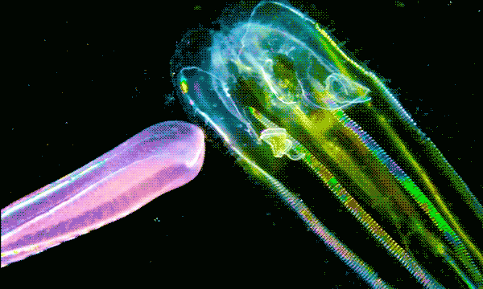
Thanks!

